Slide 1
Student Council Fundraiser
Fall Fundraiser Results

Slide 2
Fundraiser Overview
Student Services Auction
  Students donated time and skills
  Comunity members bid for these skills
  Money raised will go toward the High School’s Library Resoration Fund

Slide 3
Fall Fundraiser Team

Slide 4
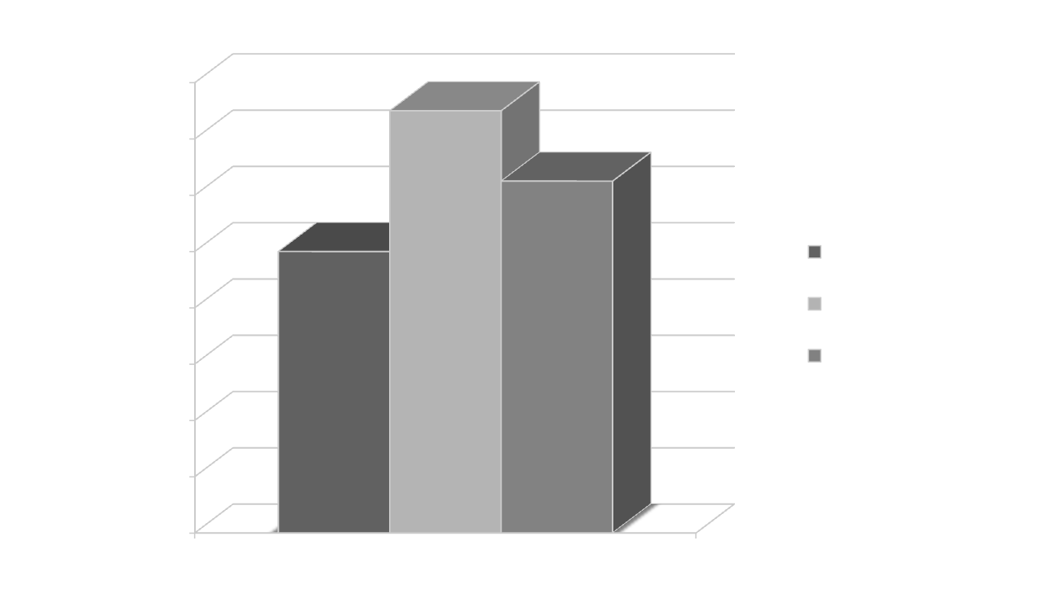
Money Raised

